Slide 1
Design Concepts

Slide 2
Introduction
Software design sits at the technical kernel of software engineering and is applied regardless of the software process model that is used.
Beginning once software requirements have been analyzed and specified, software design is the first of three technical activities—design, code generation, and test—that are required to build and verify the software.
Each activity transforms information in a manner that ultimately results in validated computer software.

Slide 3
Software Design is the process to transform the user requirements into some suitable form, which helps the programmer in software coding and implementation.
During the software design phase, the design document is produced, based on the customer requirements as documented in the SRS document.
Hence the aim of this phase is to transform the SRS document into the design document.

Slide 4
The following items are designed and documented during the design phase:
Different modules required.
Control relationships among modules.
Interface among different modules.
Data structure among the different modules.
Algorithms required to implement among the individual modules.

Slide 5
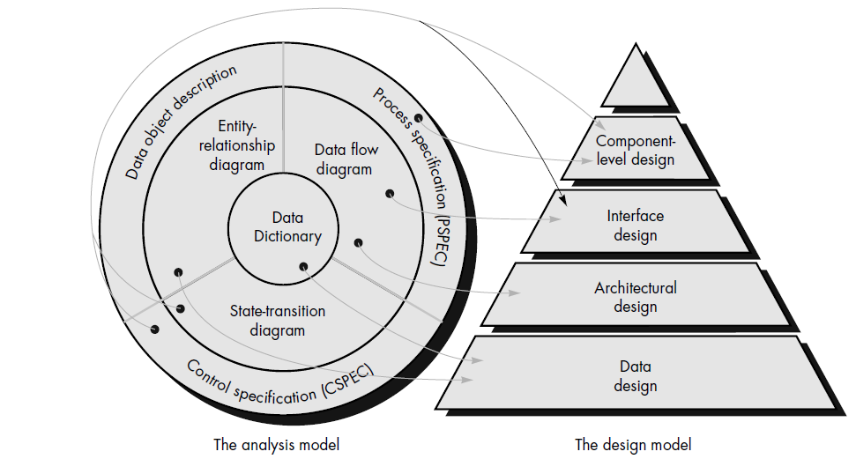

Slide 6
Data Design
The data design transforms the information domain model created during analysis into the data structures that will be required to implement the software.
The data objects and relationships defined in the entity relationship diagram and the detailed data content depicted in the data dictionary provide the basis for the data design activity.
Part of data design may occur in conjunction with the design of software architecture.
More detailed data design occurs as each software component is designed.

Slide 7
Architectural Design
The architectural design defines the relationship between major structural elements of the software, the “design patterns” that can be used to achieve the requirements that have been defined for the system, and the constraints that affect the way in which architectural design patterns can be applied .
The architectural design representation— the framework of a computer-based system—can be derived from the system specification, the analysis model, and the interaction of subsystems defined within the analysis model.

Slide 8
Interface Design
The interface design describes how the software communicates within itself, with systems that interoperate with it, and with humans who use it.
An interface implies a flow of information (e.g., data and/or control) and a specific type of behavior.
Therefore, data and control flow diagrams provide much of the information required for interface design.

Slide 9
The component-level design transforms structural elements of the software architecture into a procedural description of software components.
Information obtained from the PSPEC ( Process Specification), CSPEC (Control Specification) , and STD (Software Test Description) serve as the basis for component design.

Slide 10
The importance of software design can be stated with a single word—quality.
Design is the place where quality is fostered in software engineering.
Design provides us with representations of software that can be assessed for quality.
Design is the only way that we can accurately translate a customer's requirements into a finished software product or system. Software design serves as the foundation for all the software engineering and software support steps that follow.
Without design, we risk building an unstable system—one that will fail when small changes are made; one that may be difficult to test; one whose quality cannot be assessed until late inthe software process, when time is short and many dollars have already been spent.

